Slide 1
OPTIMIZING PUBLIC TRANSIT OPERATIONS
An Exploratory Data Analysis of public transportation
Presented by: Fadekemi Adefemi

Slide 2
BUSINESS INTRODUCTION
MetroMove Transit Solutions is a public transportation service provider operating in multiple cities.
They manage and analyze thousands of daily trips taken via buses, trains, ferries, and trams.
The company's mission is to provide efficient, affordable, and timely public transportation services while leveraging data to improve passenger experience and optimize operations.

Slide 3
PROBLEM STATEMENT
MetroMove has collected a large volume of trip data but lacks insights into trip performance, passenger behaviour, and fare patterns due to messy, inconsistent, and incomplete records. As part of their new data-driven initiative, they want to clean, explore, and summarize their trip records to identify inefficiencies and patterns that can drive operational improvements.

Slide 4
RATIONALE FOR THE PROJECT
The rationale for this project are to:
Understand passenger usage patterns.
Evaluate the performance of different transport modes.
Analyze how trip characteristics impact customer experience.

Slide 5
DELIVERABLES
Data Cleaning
Data Explorations
Descriptive Statistics
Time-series Analysis
Univariate/Bivariate/Multivariate Analysis
Visualizations
Jupyter Notebook containing comments and recommendations

Slide 6
WORKFLOW
Import necessary libraries and read the dataset
Understand data structure and explore the data
Standardized transport mode names (Bus, Train, Ferry, Tram)
Fixed station naming issues (whitespace, casing)
Converted Departure_Time and Trip_Date to datetime format
Derived new features: Hour, Day, Month, Weekend/Weekday, Revenue, Fare per Passenger
Handled missing values in Passenger_Count, Fare_Amount, Trip_Duration_Minutes
Identified outliers using IQR method, visualized with histogram and boxplot

Slide 7
KEY PERFORMANCE INDICATOR
Total number of trips: 1,000
Total number of passengers: 49,039.0
Total Revenue($): 1,248,668.18
Average duration of trips(minutes): 94.59

Slide 8
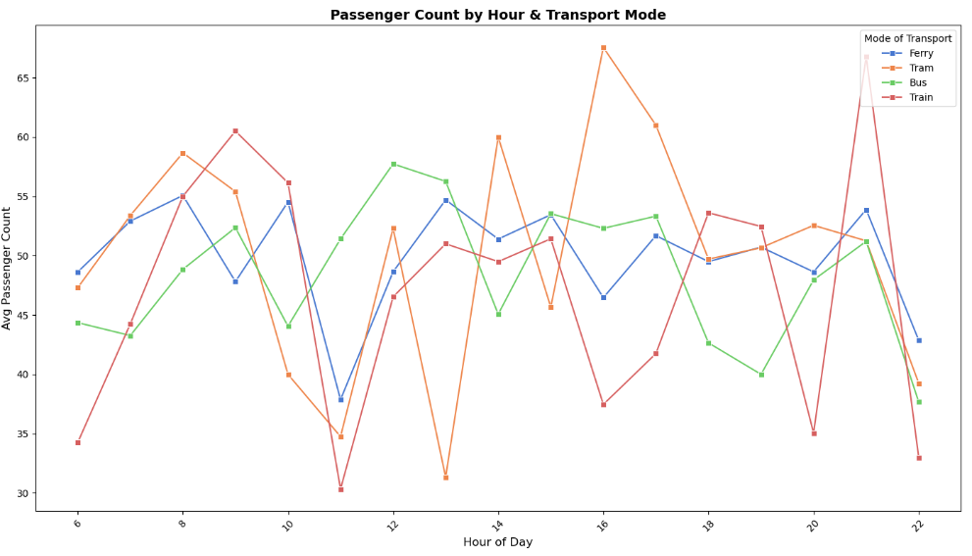
TIME SERIES ANALYSIS
INSIGHT: Tram dominates the evening rush (18:00), Train follows a dual commuter pattern (9:00 & 21:00), Ferry stays steady throughout the day with modest peaks, and Bus stands out with mid-day strength (12–13:00). Morning commuters rely more on Train and Ferry, mid-day belongs to Bus, while evening is led by Tram and Train.

Slide 9
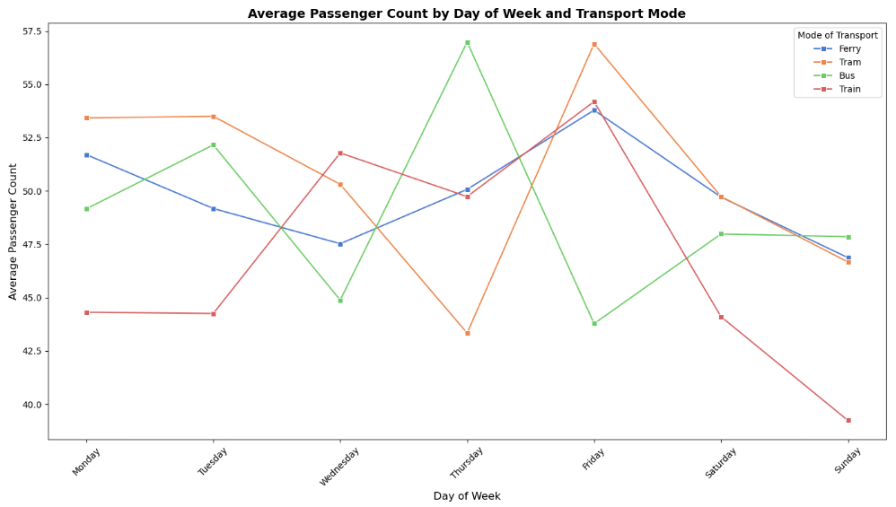
TIME SERIES ANALYSIS
INSIGHT: Passenger volumes peak mid–late week, with Thursday strongest for Bus and Train and Friday for Ferry and Tram, reflecting end-of-week business and pre-weekend travel. Demand is work-driven, with consistent weekday ridership, sharp weekend declines (especially Train), and minimal leisure travel. This confirms that revenue is primarily tied to commuter patterns rather than weekend usage.

Slide 10
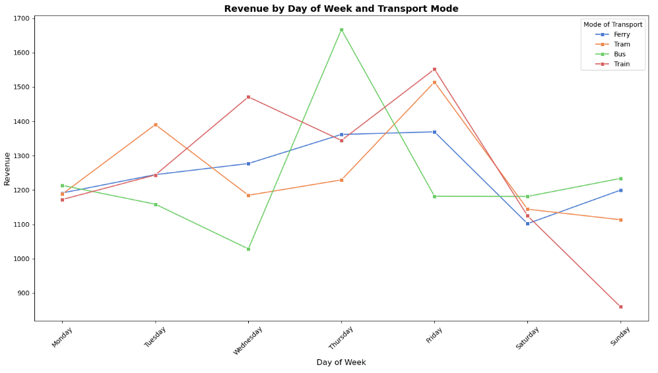
TIME SERIES ANALYSIS
INSIGHT: This reveals a weekday-centered revenue cycle: earnings are strongest mid-week especially on Thursday with Bus and Train showing the greatest fluctuations, while Ferry demonstrates the most stability. Weekend revenues consistently decline, most notably for Train and Tram, reflecting the network’s dependence on work-related travel rather than leisure activity.

Slide 11
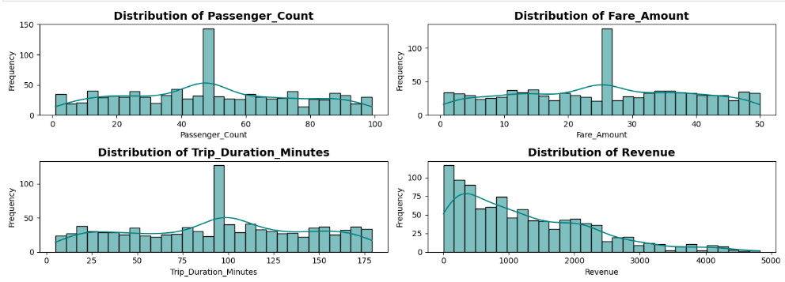
UNIVARIATE ANALYSIS(Numerical columns)
INSIGHT: Passenger_Count, Fare_Amount, Trip_Duration_Minutes show similar patterns which is relatively uniform base distributions with dominant spikes at specific values frequency of 40-45 passengers, 25-30 fare units and 100 minutes respectively, suggesting standardized service offerings or route types while Revenue is rightly skewed probably because more trips are very long with low fares and fewer trips are very short with very high fares, invariably, there are no correlation between the trip duration and the revenue generated. Hence the company have to standardize trips fare by the duration of trips.

Slide 12
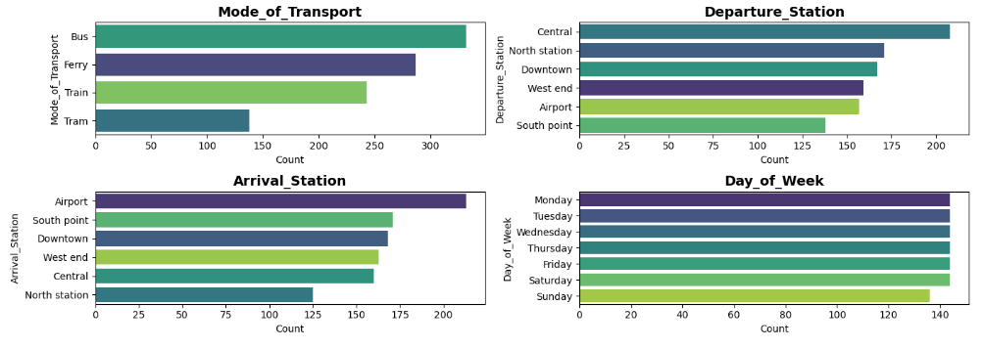
UNIVARIATE ANALYSIS(Categorical columns)
INSIGHT: Bus and Ferry are dominant transport modes. Central station is the main departure hub while Airport is the top arrival destination. Usage is highest on weekdays (Mon-Wed) with Sunday showing lowest activity.

Slide 13
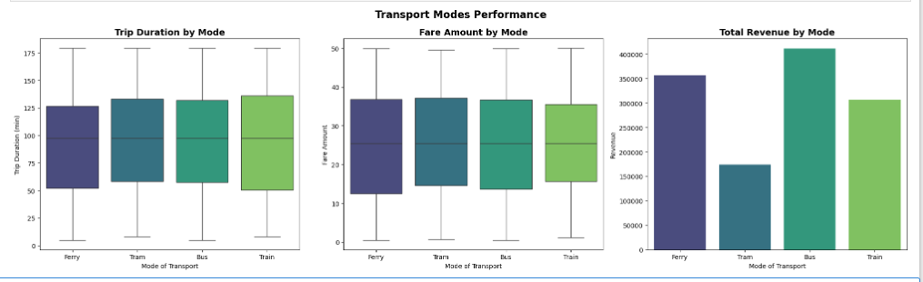
BIVARIATE ANALYSIS
INSIGHT:
Trip Duration: All modes (Ferry, Tram, Bus, Train) have comparable average trip durations (~100 min), with a wide range up to 180 min.
Fare Amount: Median fares are similar across modes (~25 units), suggesting a standardized pricing structure.
Revenue: Buses generate the highest total revenue, followed by Ferries and Trains, while Trams lag significantly.

Slide 14
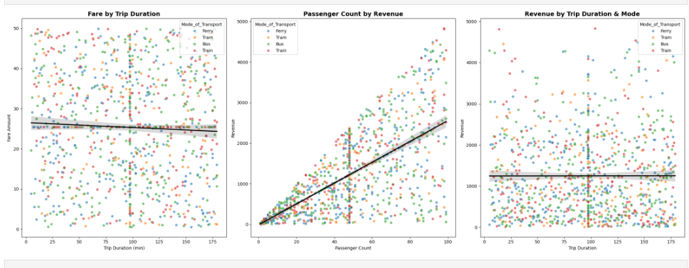
BIVARIATE ANALYSIS
INSIGHT:
Scatter Plot 1: Fares don’t strongly increase with longer trip durations. In fact, there’s a slight decline, suggesting fares might be fixed or capped beyond a certain time, regardless of how long the journey lasts.
Scatter Plot 2: confirms a strong positive correlation/ linear relationship between passenger count and revenue across all transportation modes, indicating that passenger volume drives more revenue. T
Scatter Plot 3: Revenue doesn’t scale with trip duration.
Mode coloring shows similar patterns across all transport types, so this behavior is consistent across ferries, trams, buses, and trains.
The horizontal stripes in fares and revenues indicate a flat fare structure, where multiple trips cluster at fixed price points.

Slide 15
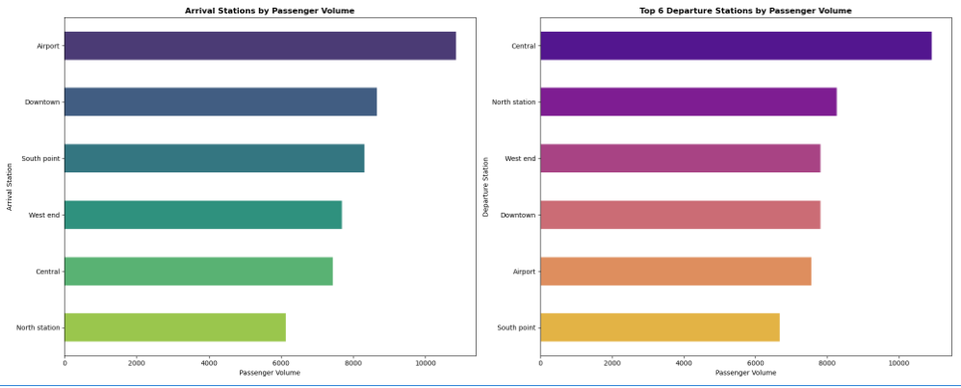
BIVARIATE ANALYSIS
INSIGHT:
Chart 1: Airport is the dominant arrival destination than all other station, Downtown ranks second while South point, West end, Central and North station have relatively similar volumes.
Chart 2: Central leads as the top departure point, North station and West end follow closely, Downtown and Airport have moderate departure volumes and South point has the lowest departure volume among the top 6 departure stations,

Slide 16
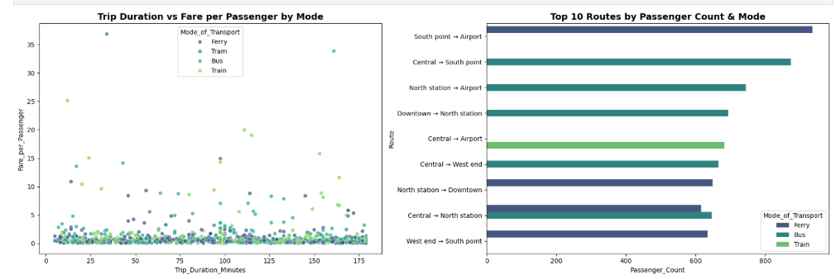
BIVARIATE ANALYSIS
INSIGHT:
Chart 1: Across all transport modes, fare per passenger remains clustered at the lower range mostly between 0–5 units regardless of trip duration
Chart 2: The South Point → Airport route (Ferry) has the highest passenger count among all routes. most routes are dominated by Buses.

Slide 17
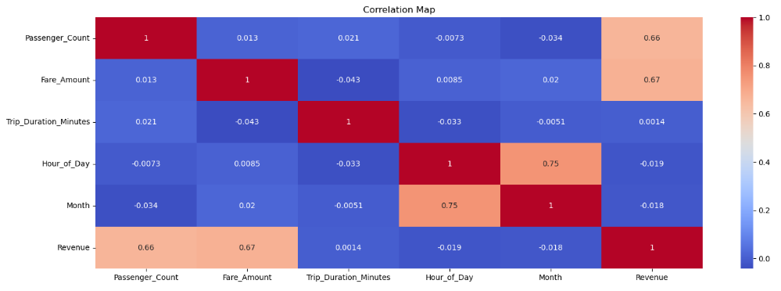
MULTIVARIATE ANALYSIS
INSIGHT:
Revenue correlates moderately with both Passenger_Count (0.66) and Fare_Amount (0.67), indicating that more passengers generally mean higher fares, and higher fares drive revenue.
Trip_Duration_Minutes shows minimal correlation with other factors, suggesting trip length doesn't strongly predict fare amounts or passenger counts hence minimal impact on revenue.
Most relationships are weak, indicating consistent demand patterns across different times, suggesting that factors like hour of day, month, and trip duration don't dramatically affect passenger counts, fares, or revenue - meaning demand and pricing remain relatively stable regardless of when trips occur or how long they take.

Slide 18
SUMMARY
Trave Demand Patterns
Strong weekday usage with mid-week peaks especially Thursday
Weekend passenger counts and revenues fall sharply, showing limited leisure travel demand.
Clear rush hour behavior: morning(8-9AM) and evening (6-9PM), with evening demand often stronger.
Mode Specific Insights
Bus: Strongest mid week revenue peaks
Train: Classic work travel profile with sharp weekend declines.
Tram: Evening dominant, likely linked to leisure or residential travel.
Ferry: Most stable, consistent weekday usage with moderate weekend dips.
Revenue Trends
Weekday revenue dominates; Thursday is the strongest day overall..
Weekend weakness across all modes highlights reliance on work related travel.
Hourly revenues align with passenger flows.
System Reliance
The system is anchored in business/work travel rather than leisure.
Passenger volumes and revenue patterns confirms pricing consistency across time periods

Slide 19
RECOMMENDATIONS
Capacity & Scheduling Optimization
Increase capacity during peak weekday hours (esp. Thursday evenings).
Scale back services during low-demand windows (midday, weekends, late evenings).
Revenue Diversification
Develop weekend promotions or leisure packages to smooth demand.
Explore partnerships with entertainment, shopping, or tourism providers to boost off-peak ridership.
Mode-Specific Strategies
Bus & Train: Adjust resources to handle weekday surges, reduce weekend inefficiencies.
Tram: Target evening and leisure riders with tailored pricing.
Ferry: Market stability to tourists and cross-water commuters to sustain steady usage.
Pricing & Incentives
Introduce dynamic/off-peak pricing to drive demand in weaker periods.
Loyalty schemes for frequent weekday commuters and bundled passes for weekend travelers.
Operational Improvements
Leverage demand insights to balance fleet allocation.
Use low-demand windows for maintenance to minimize service disruption.

Slide 20
THANKS FOR LISTENING Any Question?

